Slide 1
AVION
Preliminary Design Review
Charlie Stone ∙ Valeria Cecena ∙ Quinn Kennerly
Lena Pattamadilok ∙ Jose Hernandez Negrete ∙ Mostafa Hashem

Slide 2
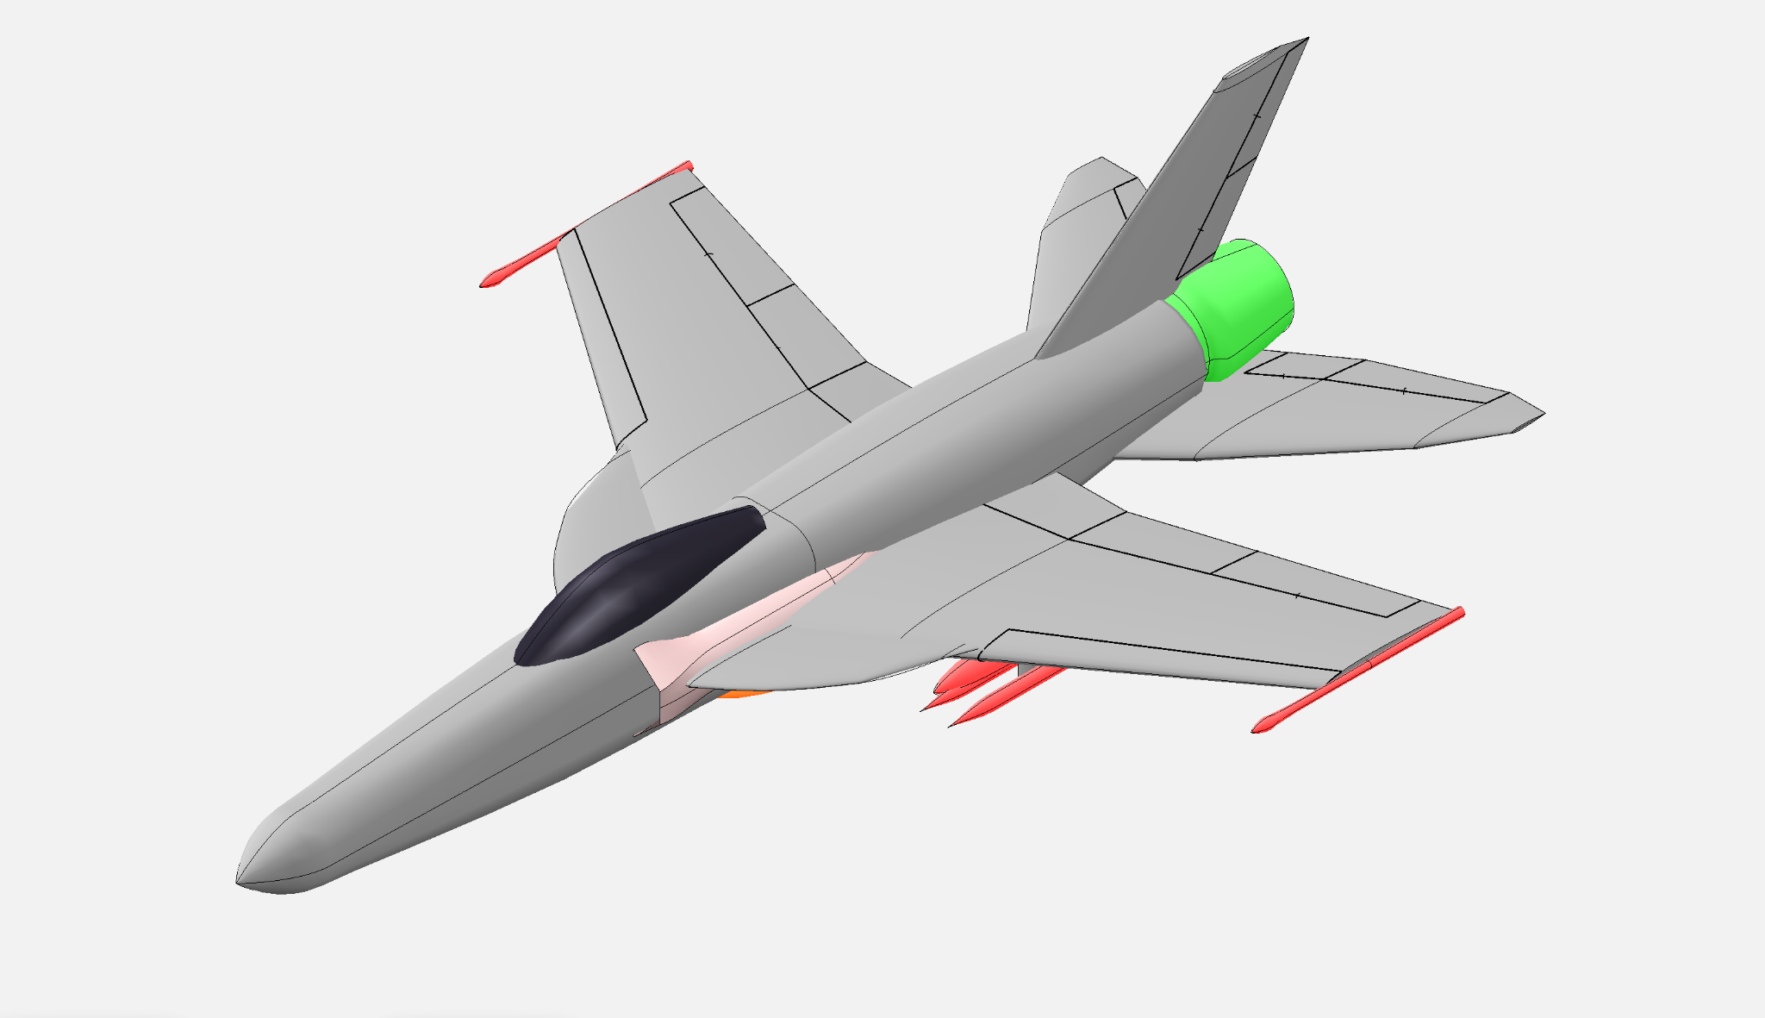
Overview
Objective
→ Key Characteristics
→→ Detailed Part Overview
→→→

Slide 3
Objective + RFP Mission
Objective: Design a single-engine carrier-capable supersonic strike aircraft
RFP Requirements:
Mach 1.6-2.0 high altitude dash capability
Carrier compatible configuration
TOGW under 90,000 lbs
700-1000 nm. combat radius
Notes:
Harvey said: we do not need to include a slide about the RFP; it can just be referenced through the other slides

Slide 4
Key Characteristics
YF-52 COYOTE
Affordability
Single engine
External avionics
(Comparable Aircraft) <- replace with aircraft name

Slide 5
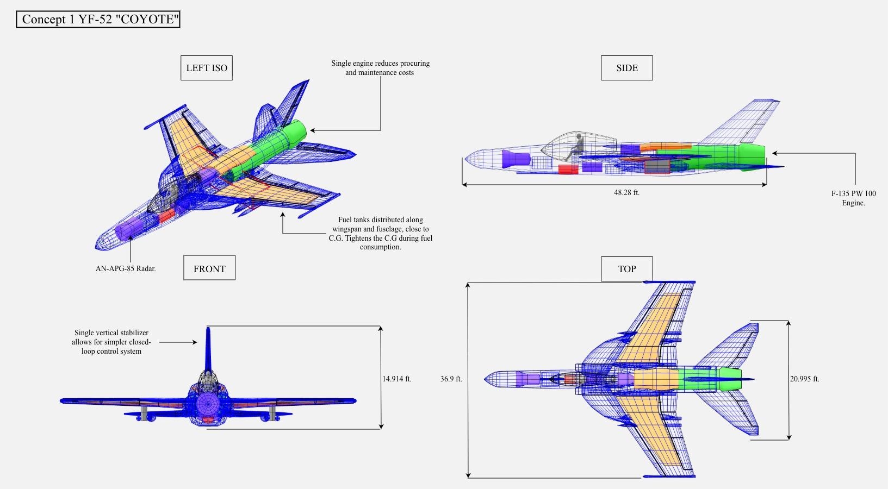
Dimensioned three-view drawing of the COYOTE

Slide 6
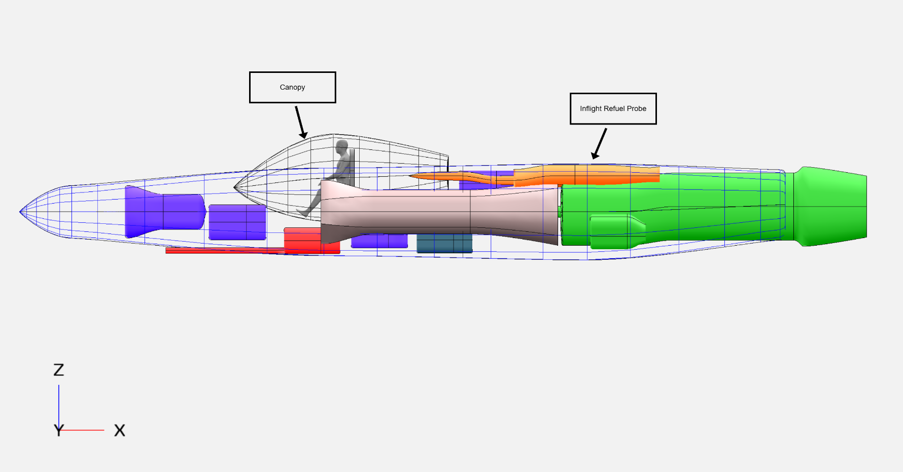
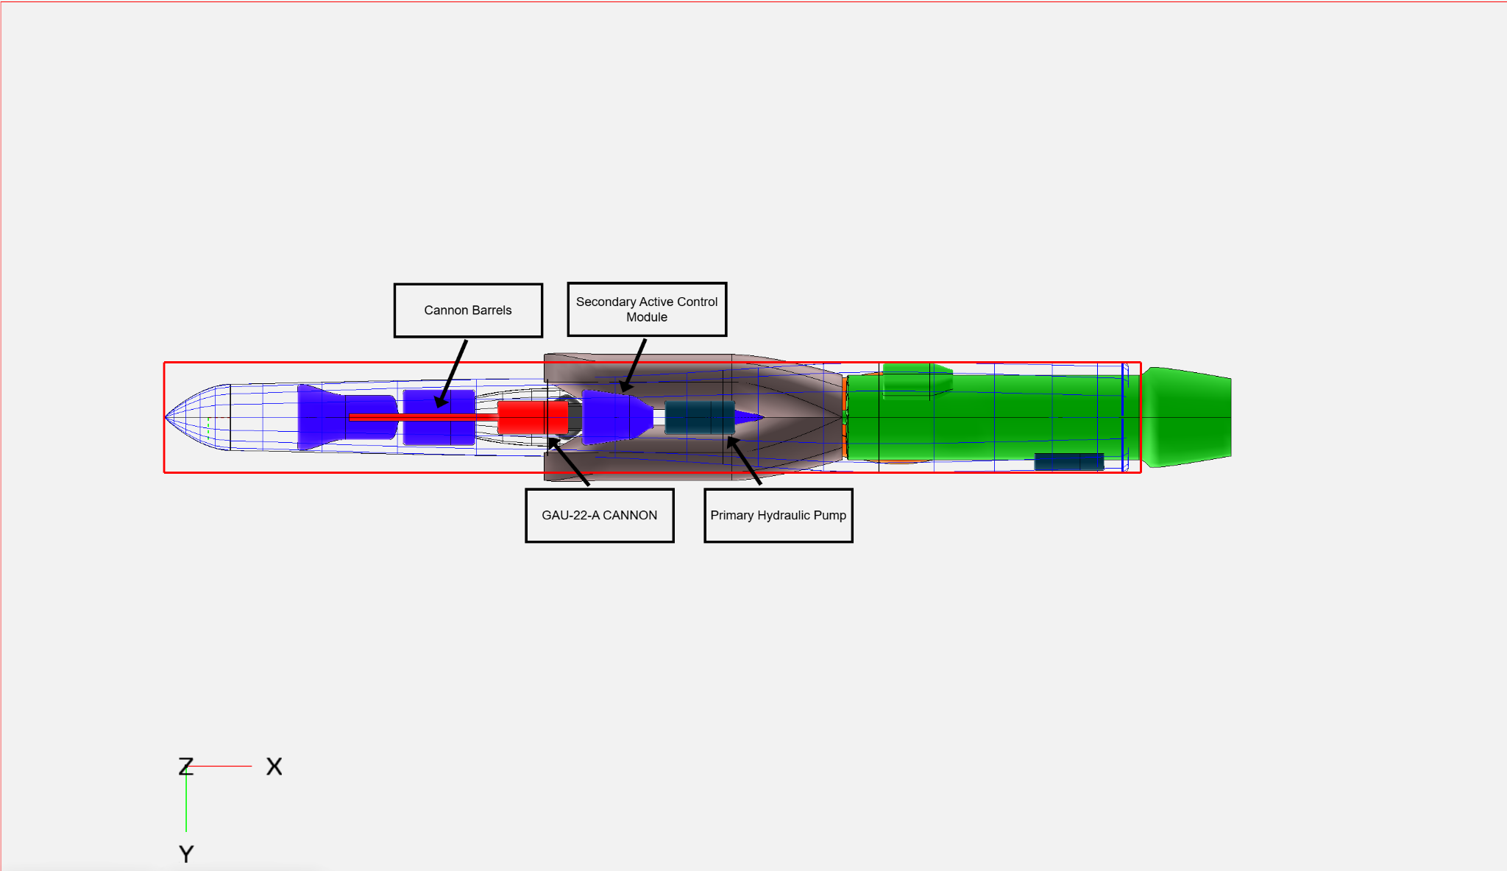
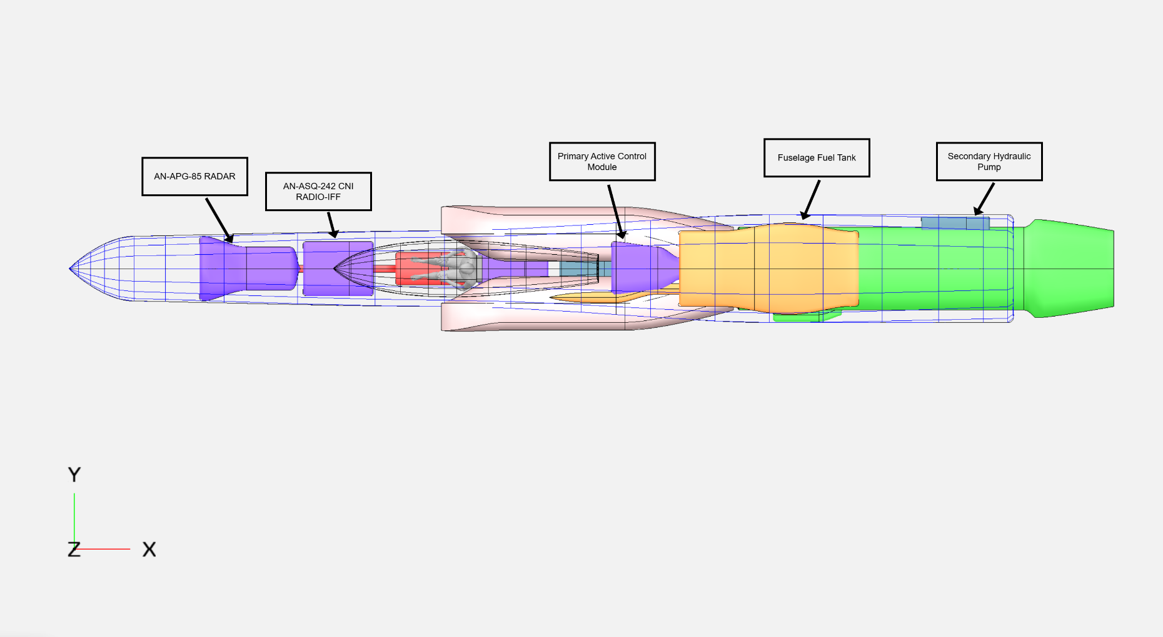
Fuselage

Slide 7
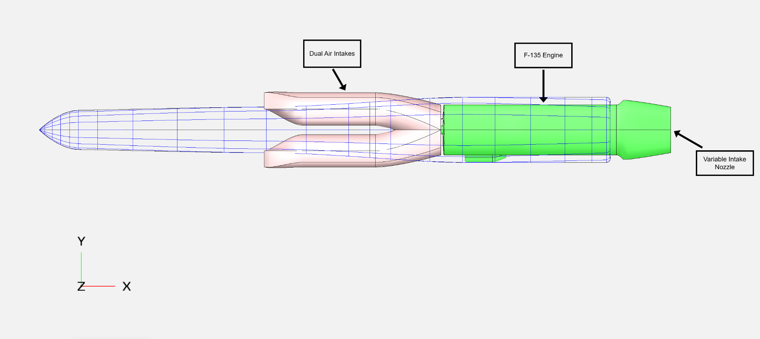
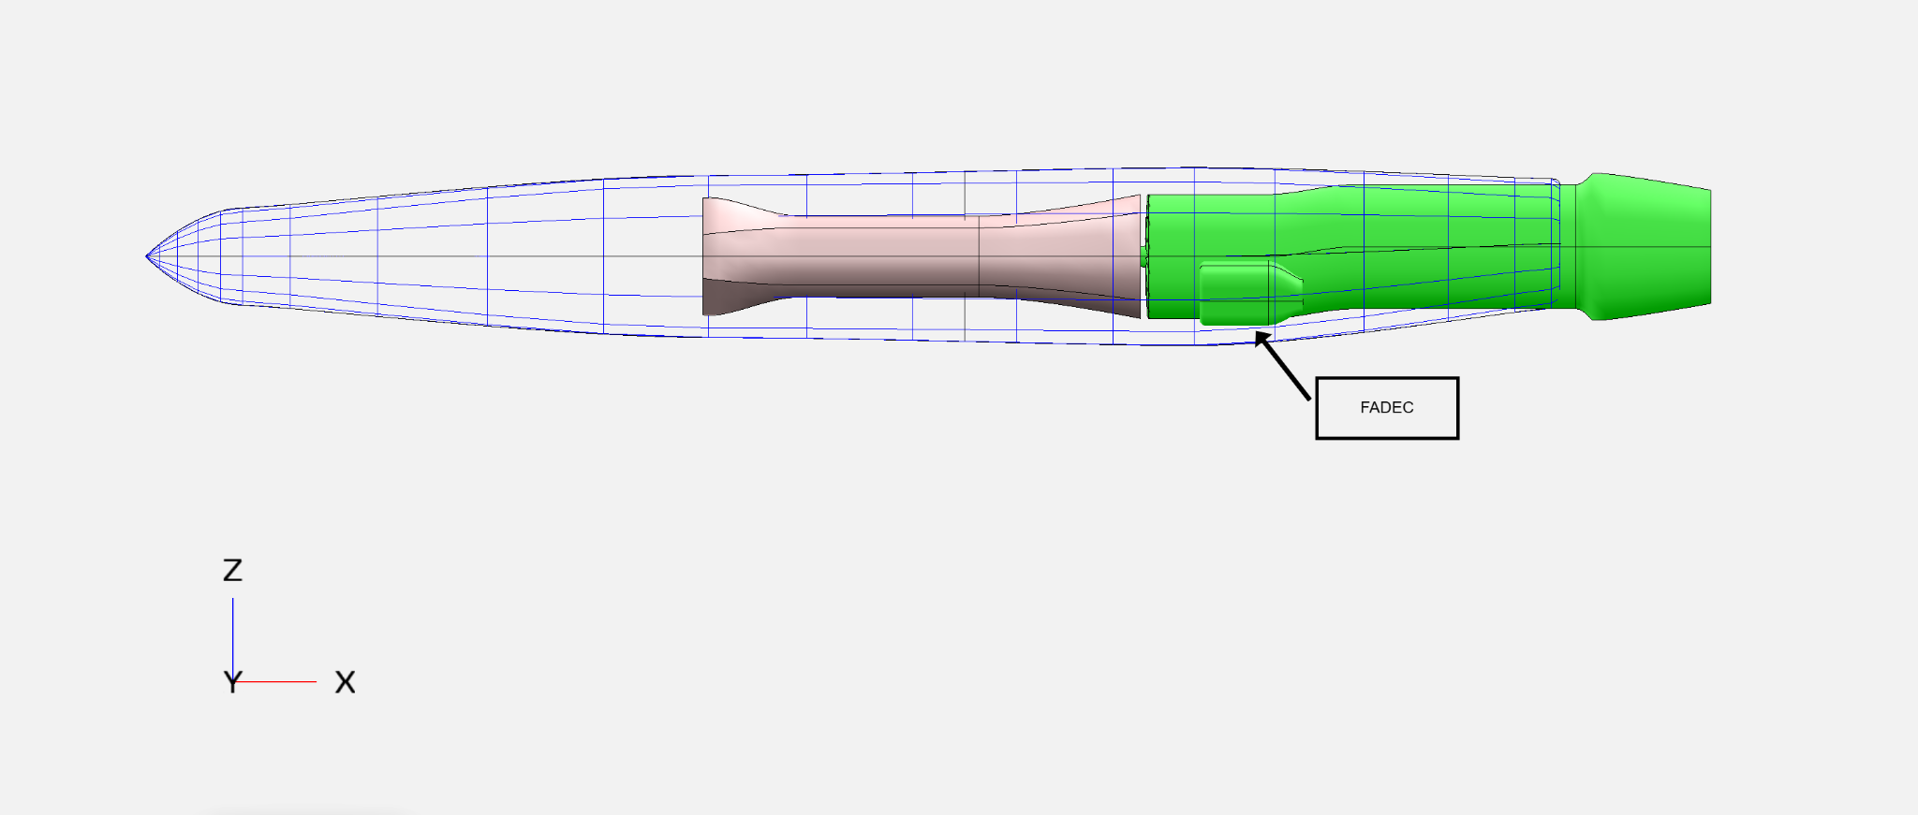
Powertrain

Slide 8
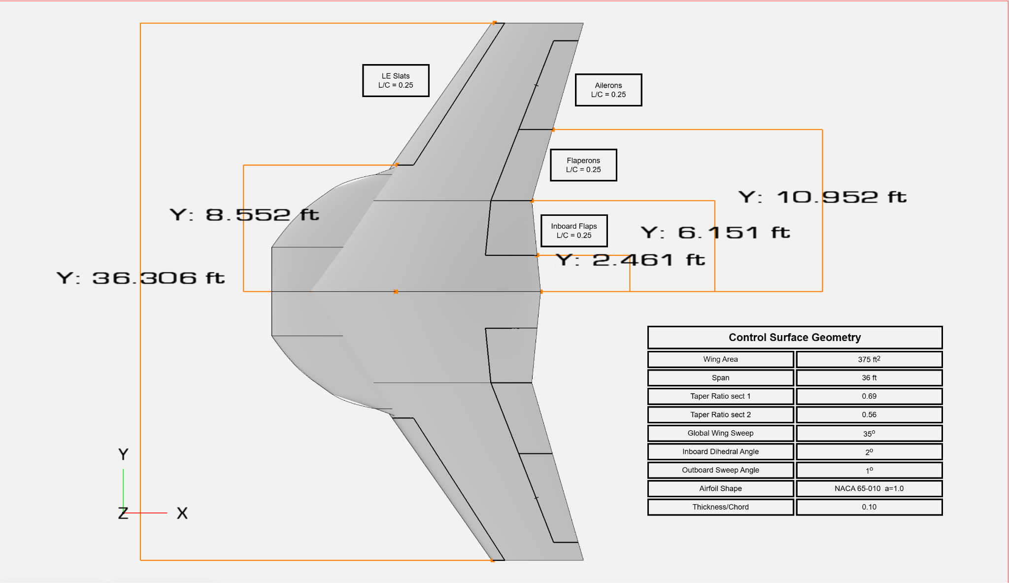
Control Surfaces

Slide 9
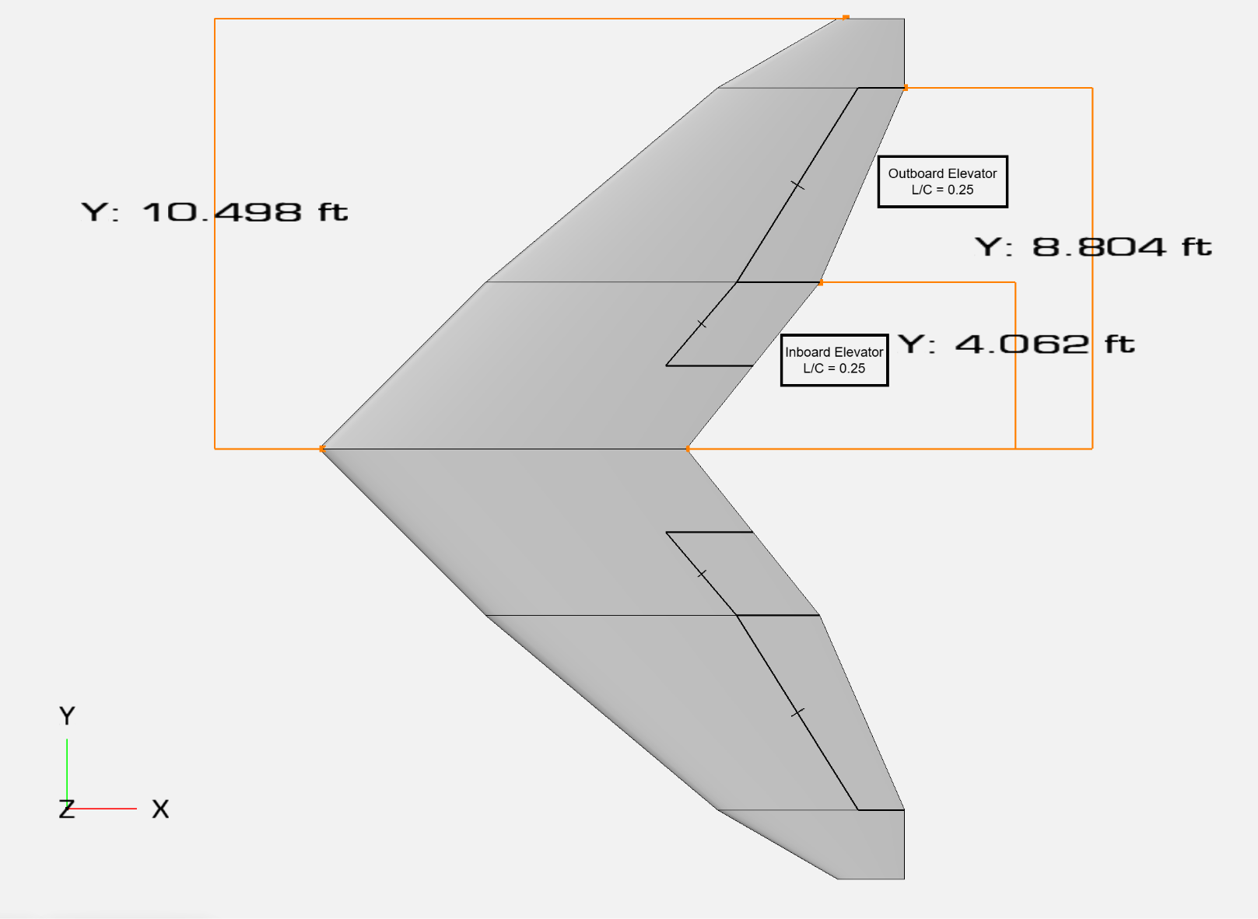
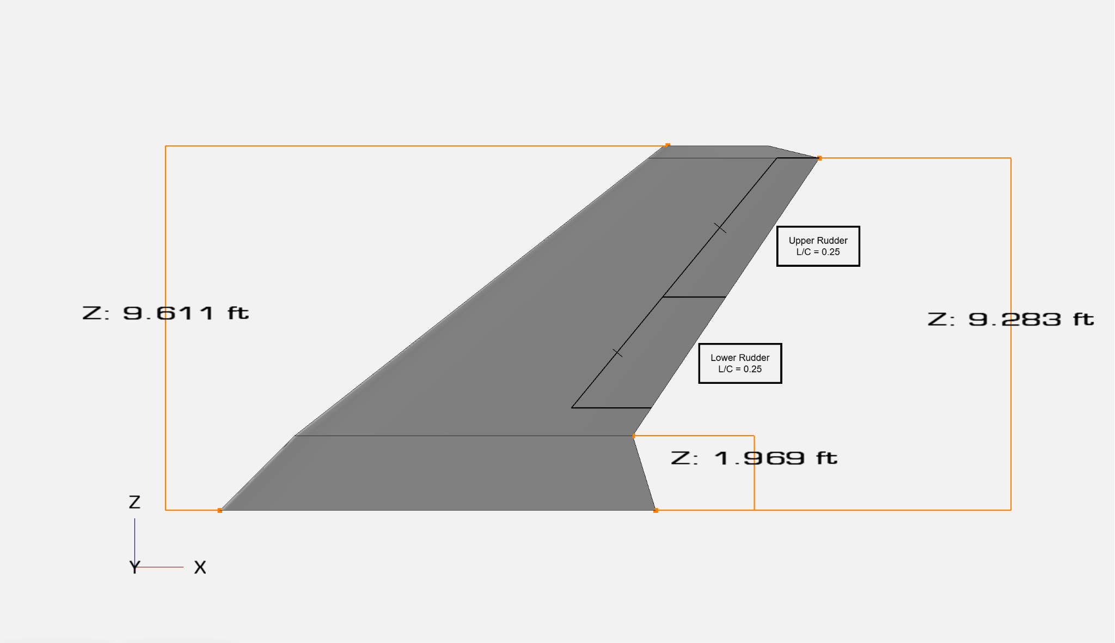
Empennage

Slide 10
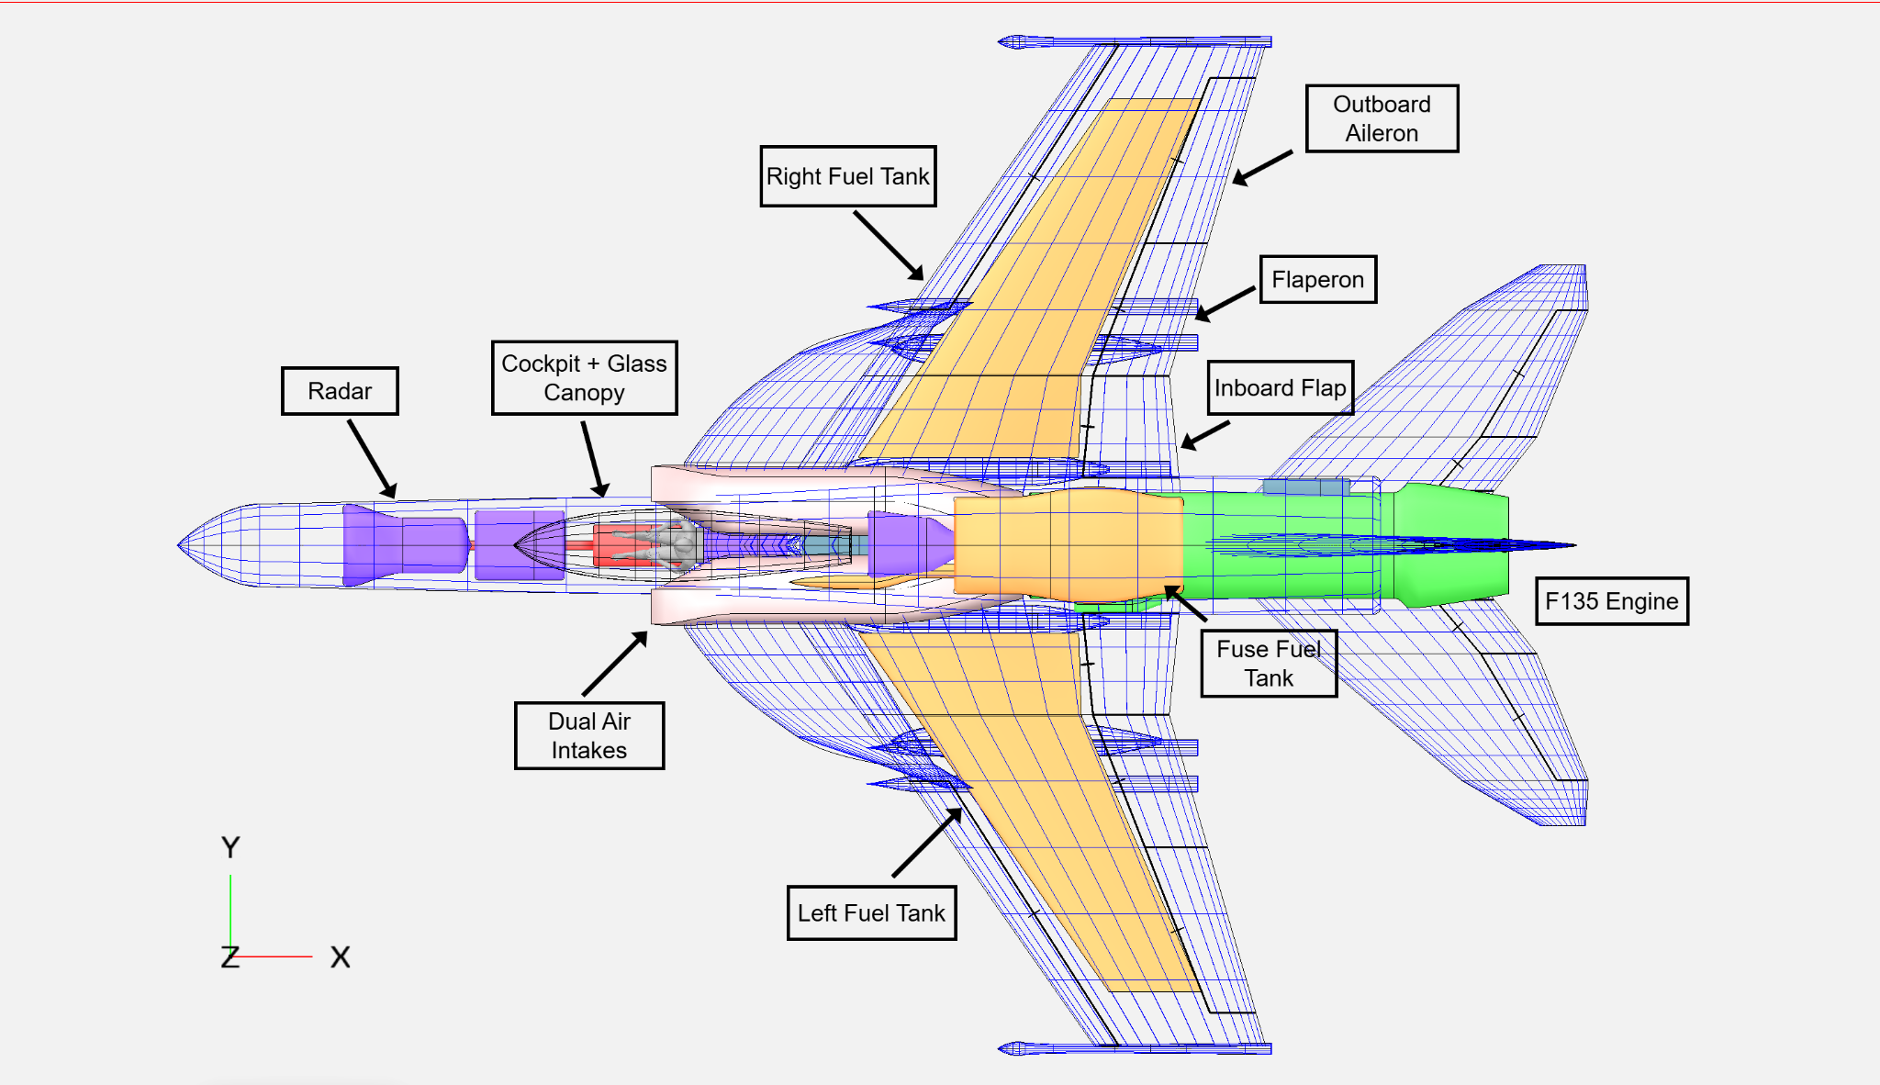

Slide 11
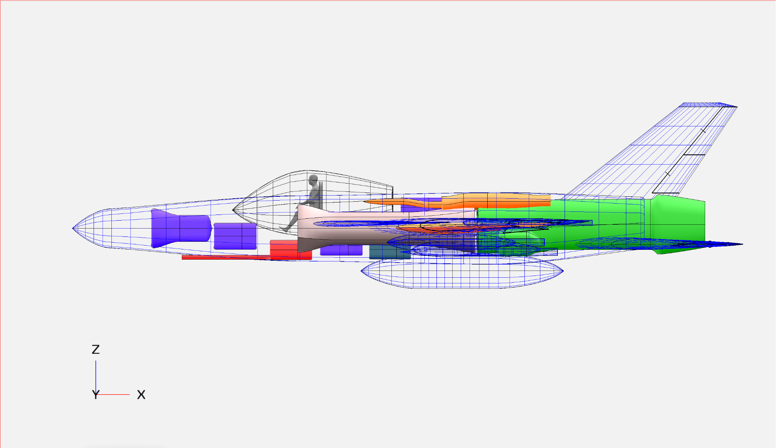

Slide 12
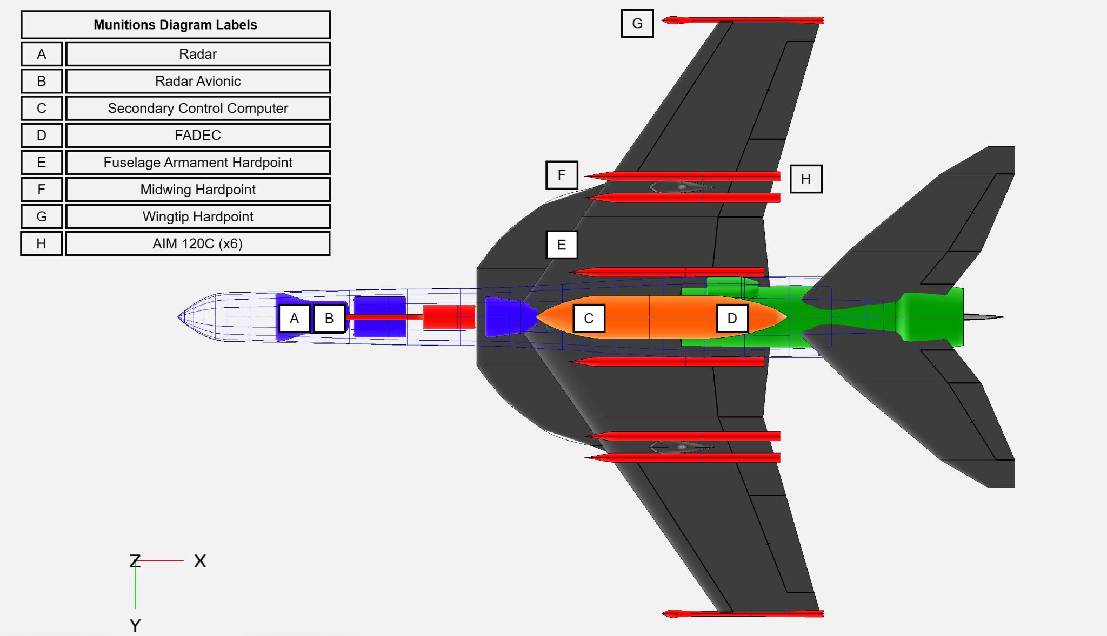

Slide 13
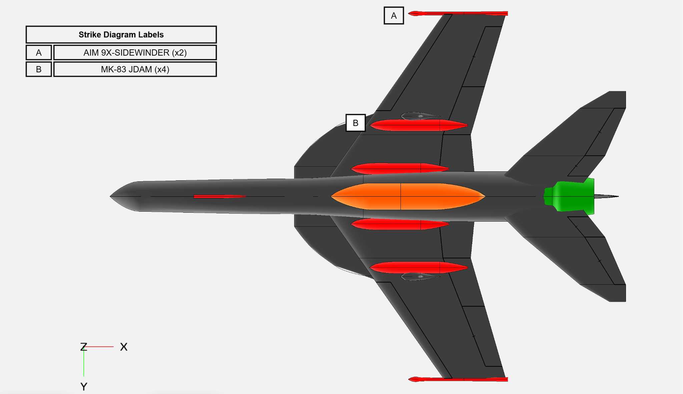

Slide 14
Thrust–area (T–S) graph
Will have notes, but should primarily focus on the graph and be able to explain what each component means
(please please please let charlie do this one)

Slide 15
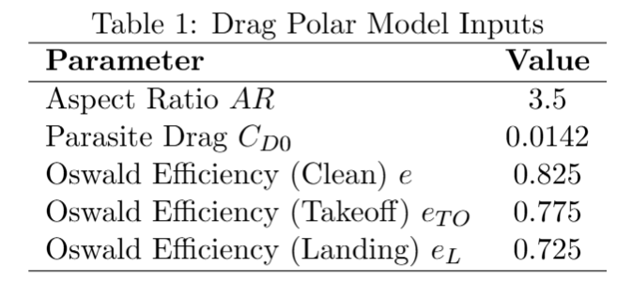
Drag Polar Model
Drag polar used for first-order preliminary sizing
CD0 from OpenVSP parasite drag tool
Induced drag found with finite wing approximation
Notes:
Quin also maybe? Well talk

Slide 16
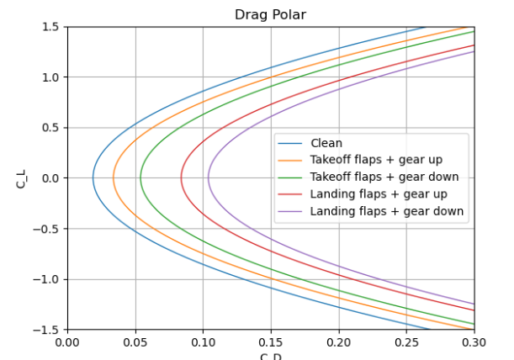
Drag Polar Plot
Clean configuration has lowest drag
High-lift result in higher CD0
Landing configuration -> largest drag increase
Gear deployment -> more parasite drag

Slide 17
Discussion
Should answer:
How your design meets or exceeds your stated objectives.
Major innovations in your design. (Strakes(LERX), Diverterless Supersonic Inlet intakes,
Risks (or open issues) and mitigation strategies. (engine sizing finding design parameters of EPU, single engine, extended development cycle for T/S,

Slide 18
How our design meets RFP requirements
Single-engine configuration (F135 class) reduces acquisition and life-cycle cost compared to twin-engine aircraft
Higher thrust-to-weight ratio (~0.91) improves maneuverability and acceleration
Combat radius ≥ 700 nmi achievable through efficient aerodynamic configuration and fuel fraction sizing
Sustained turn performance ≥ 8 deg/s meets maneuverability requirements
Carrier compatible geometry that satisfies both carriers (CVN-68 / CVN-78 ) operations
Mach 2 dash capability exceeds the required Mach 1.6

Slide 19
Comparison with existing aircrafts
Parameter | Coyote | F/A - 18 E/F | F-35C
Engines | 1 x F135 | 2 x F414 | 1 x F135
Thrust | 35,000 lbf | 44,000 lbf | 43,000 lbf
TOGW | 37,000 | 66,000 | 70,000
Wing Area | 400 ft^2 | 500 ft^2 | 670 ft^2
T/W | 0.91 | 0.93 | 0.87
Max Speed | Mach 2.0 | Mach 1.8 | Mach 1.6
Unit cost | $55 M | $73 M | $100M +

Slide 20
Performance Comparison
Feature | Coyote | Advantage
AR | 3.5 | Maneuverability
Wing loading | ~ 80lb/ft^2 | Supersonic drag opt.
Static Margin | Slightly negative | Agility
LERX area | ~ 70 ft^2 | High-alpha lift
Engine Type | Low-bypass turbofan | Supersonic dash

Slide 21
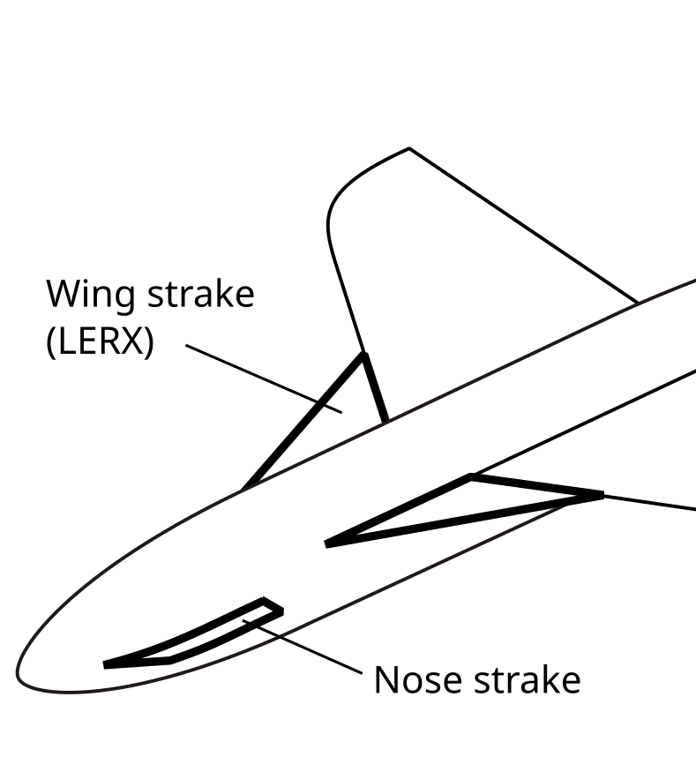
Major Innovations
Strakes/ Leading-edge root extensions
Purpose:
Generate Vortices at high AOA
Delay flow separation
Improve lift and maneuverability
Benefits:
Increased CLmax
Improved dogfight performance
Better carrier landing control
Aircrafts using similar system:
F/A - 18
Sukhoi Su-27
F-16

Slide 22
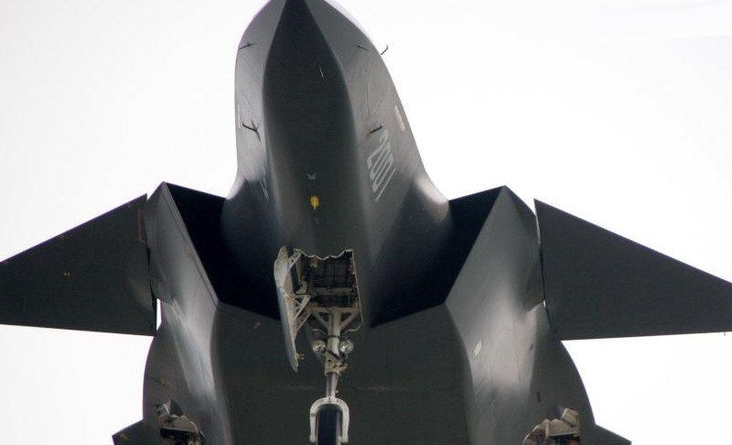
Major Innovations
2. Diverterless supersonic Engine Intakes
Advantages:
Reduce weight
Lower drag
Improved stealth potential
Reduced maintenance costs
Fewer moving components
Aircrafts using similar system:
F-35
Sukhoi Su-75
Chengdu J-20

Slide 23
Risks
Engine failure
Engine Sizing
Auxiliary power unit
Higher consequences
Mitigation:
Use of modern, reliable engine (F135)
Redundant electrical and hydraulic systems
Insufficient performance
Mitigation:
Iterative constraint diagram analysis
Benchmarking against existing fighter engines
Reduced survivability engine failure scenario
Mitigation:
Prioritize APU sizing for enhanced survivability

Slide 24
Questions?

